Slide 1
Guided Capstone Presentation
Rishabh Padore

Slide 2
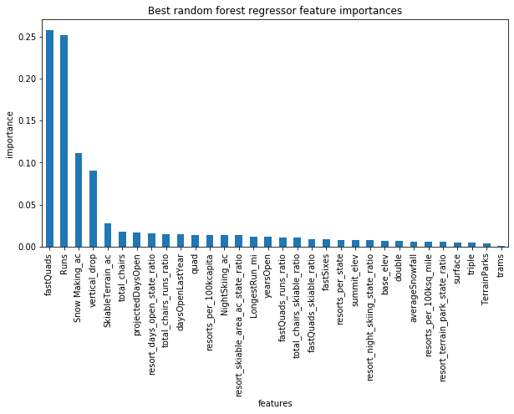
Top 4 Factors affecting the price
There are four main factors affecting the price and therefore modification of these factors can lead to a justification of the price adjustment

Slide 3
Short Term Recommendations
Based on the study a combination of Fast Quads, Runs and Vertical justifies at ticket increase of $1.99 per day, divided into: $1.70 for additional Vertical; $0.29 for additional Fast Quad; and $0.00 for addition of Run
An additional Fast Quad on its own supports $0.29 per ticket, $507,246 revenue per year , not enough to justify the $1.540,000 in additional operating costs
However….
When combined with adding 150’ vertical drop to the, justifies $1.99 or $3.482,500 additional revenue per year

Slide 4
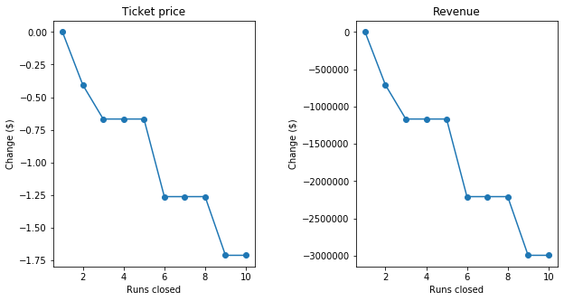
Long Term Recommendations
Increase ticket price to the minimum recommended by the study, from current $81 to $85.34 per day per customer
Reduce/close off one run from current runs available, selecting the least travelled/least popular run.

Slide 5
Going Forward
We would need to gather more data over time to predict how well our model does against the real life price of the ski data
We would also need to know the amount of visitors that each resort receives per year so that we can understand clearly the demand of the ski resorts during such times.
This is a good start

